Slide 1

TensorFlow 2.0
PRACTICAL

Slide 2
PROJECT #4 OVERVIEW

Slide 3

PROJECT #4: PREDICT HOUSE PRICES
Dataset includes house sale prices for King County in Washington, USA.
Homes that are sold in the time period: May, 2014 and May, 2015.
Data Source: https://www.kaggle.com/harlfoxem/housesalesprediction
Model inputs:
ida: notation for a house
date: Date house was sold
bedrooms: Number of Bedrooms
bathrooms: Number of bathrooms
sqft_living: home square footage
sqft_lot: square footage of the lot
floors: Total floors (levels) in house
waterfront: waterfront property
INPUTS
HOUSE
PRICE
REGRESSION MODEL
TensorFlow 2.0 PRACTICAL

Slide 4
PROJECT #4: PREDICT HOUSE PRICES
Model inputs:
condition: How good the condition is ( Overall )
grade: overall grade given to housing unit, based on King County grading system
sqft_abovesquare: footage of house apart from basement
sqft_basement: square footage of the basement
yr_built: Built Year
yr_renovated: Year when house was renovated
zipcode: zip
lat: Latitude coordinate
long: Longitude coordinate
sqft_living15: Living room area in 2015
sqft_lot15: lotSize area in 2015(implies-- some renovations)
The model should predict:
House Price
TensorFlow 2.0 PRACTICAL

Slide 5
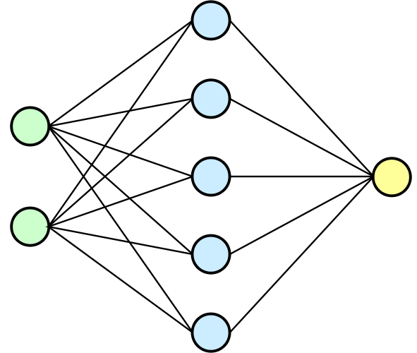
PROJECT #4: PREDICT HOUSE PRICES
BEDROOMS
TRAINED ARTIFICIAL NEURAL NETWORK MODEL
BATHROOMS
FLOORS
WATERFRONT
HOUSE PRICE
SQFT LIVING
Photo Credit: https://commons.wikimedia.org/wiki/File:Neural_network.svg
TensorFlow 2.0 PRACTICAL

